Slide 1

PUBG
PlayerUnknown Battlegrounds
IOS Assignment 3 Presenting by Group - 122
Our solution:

Slide 2
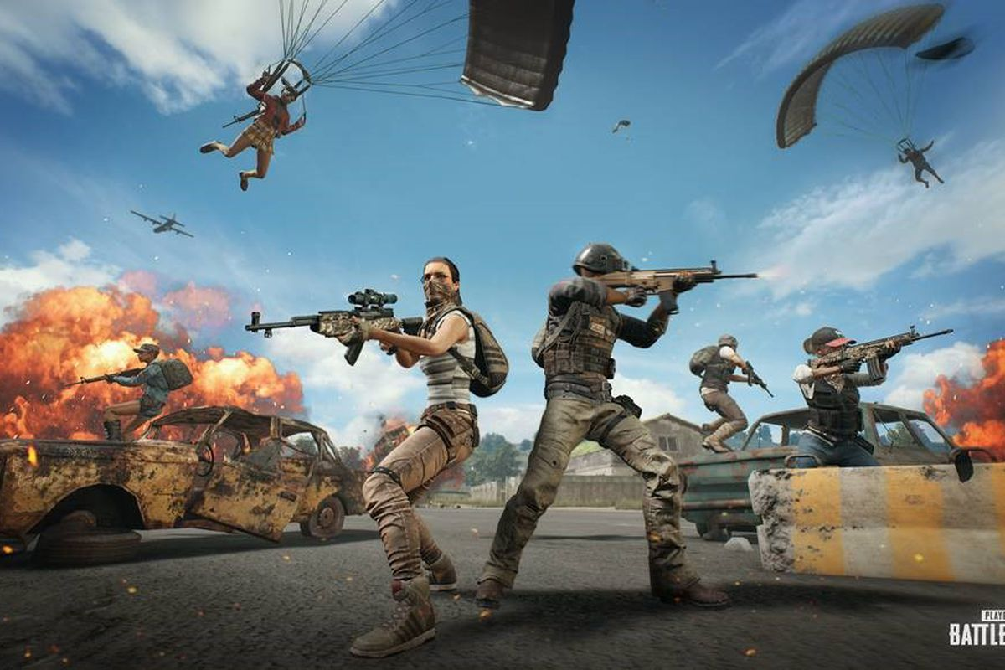
227 Million user playing pubg in 2018 making it most popular game in world wide.
100 Million active user in every day.
360 Million times PUBG has downloaded in IOS devices.

Slide 3
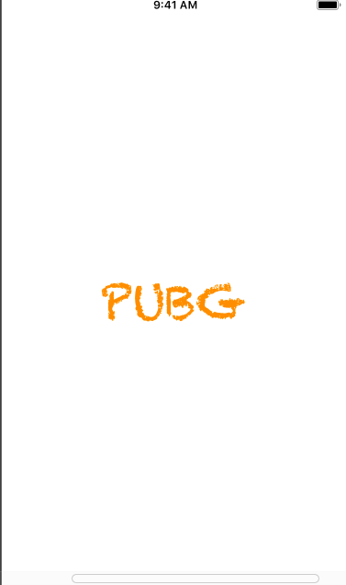
PUBG
Initial Screen

Slide 4

So, Who is our audience?
According to our idea this app is for the people who plays PUBG
User who have no idea which Gun they should take for the battlefield
Growing number of user increasing rapidly without knowing what they are playing for.
This app will help them understand different guns stats.

Slide 5
So what problem is being solved by this app?
Once the game starts we cannot pause it and get the information on google. So, this application will be used to provide guns stats during the game. For example: you can run this app background and play PUBG. whenever you need to know the stats you can swipe the app and get the information. It’s easy and user friendly.

Slide 6
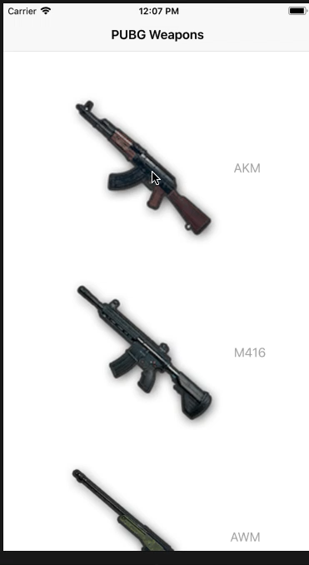
How the app is working?

Slide 7
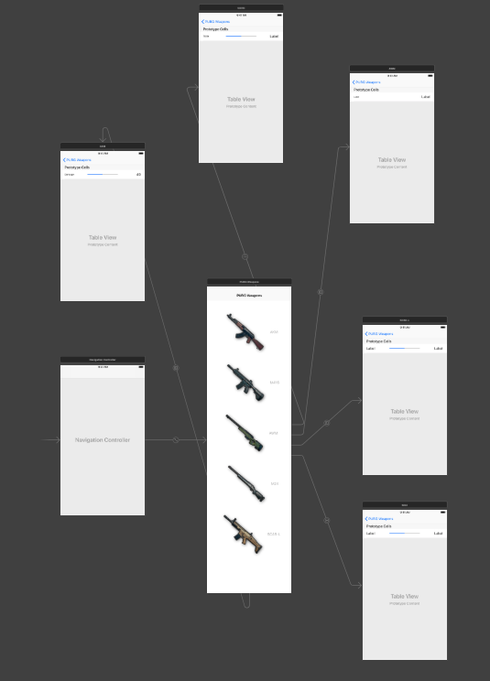
How we designed the app
Table View Cell
Cell reuse
The reuse is a very important concept for UITableView, which can significantly improve the performance of the sliding TableView. If you don't use reuse, you need to create a new one every time a new cell appears on the screen, which is very affecting the user experience for fast swipe and will take up a lot of memory overhead..

Slide 8
Thank you :)

